Slide 1
Community Service Advocacy
ACCE Annual Conference
San Diego
2019

Slide 2
Community Service Scope and Definition
Section 78300. (Amended by Stats. 2001, Ch. 734, Sec. 68.)
Cite as: Cal. Educ. Code §78300.
(a)The governing board of any community college district may, without the approval of the Board of Governors of the California Community Colleges, establish and maintain community service classes in civic, vocational, literacy, health, homemaking, technical and general education, including, but not limited to, classes in the fields of visual and performing arts, handicraft, science, literature, nature study, nature contacting, aquatic sports and athletics. These classes shall be designed to provide instruction and to contribute to the physical, mental, moral, economic, or civic development of the individuals or groups enrolled therein.
(b)Community service classes shall be open for the admission of adults and of those minors as in the judgment of the governing board may profit therefrom.

Slide 3
Who We Are
Credit
Degrees and Certificates of Achievement
Generates apportionment; student fees apply
Degree applicable and non-degree applicable
Unit bearing
Not repeatable (with exceptions)
Approval: Curriculum Committee and Governing Board
Noncredit
Certificates of completion and competency
Generates two levels of apportionment (noncredit and enhanced noncredit); no student fees
Enhanced noncredit = Career Development and College Preparation (CDCP)
No units
Repeatable
Limited to 10 different categories
Approval: Curriculum Committee, Governing Board, Chancellor’s Office
Community Ed

Slide 4
What is Our Ask
Allow general fund to be used for administrative expenses as long as enrollment fees fully cover instructional cost.
Section 78300. (Amended by Stats. 2001, Ch. 734, Sec. 68.)
Cite as: Cal. Educ. Code §78300.
(c)Governing boards shall not expend General Fund moneys to establish and maintain community service classes. Governing boards may charge students enrolled in community service classes a fee not to exceed the cost of maintaining community service classes, or may provide instruction in community service classes for remuneration by contract, or with contributions or donations of individuals or groups. The board of governors shall adopt guidelines defining the acceptable reimbursable costs for which a fee may be charged and shall collect data and maintain uniform accounting procedures to ensure that General Fund moneys are not used for community services classes.

Slide 5
What is Our Ask
Allow Community Services to keep the revenue surplus for the following year as long as the funding is used for instruction.
Section 78300. (Amended by Stats. 2001, Ch. 734, Sec. 68.)
Cite as: Cal. Educ. Code §78300.
(c)Governing boards shall not expend General Fund moneys to establish and maintain community service classes. Governing boards may charge students enrolled in community service classes a fee not to exceed the cost of maintaining community service classes, or may provide instruction in community service classes for remuneration by contract, or with contributions or donations of individuals or groups. The board of governors shall adopt guidelines defining the acceptable reimbursable costs for which a fee may be charged and shall collect data and maintain uniform accounting procedures to ensure that General Fund moneys are not used for community services classes.

Slide 6
What is Our Ask
Establish a policy for co-enrolling Community Education students (i.e., those enrolling through community services, fee-based programs) in credit classes of the college on a space-available basis.
For co-enrollment guidance, go to:
http://extranet.cccco.edu/Portals/1/ExecutiveOffice/Consultation/2012_agendas/oct_2012/FinalCommunitySvcsOfferingGuidelines10-4-12.pdf

Slide 7
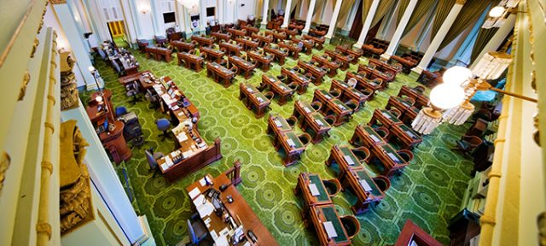
Next Steps…Where To Go From Here?
Identify one focused ask.
Education key Legislative Members and staff about Community Services.
Lay the groundwork for future legislative, regulatory, or procedural changes.
Provide solutions.

Slide 8
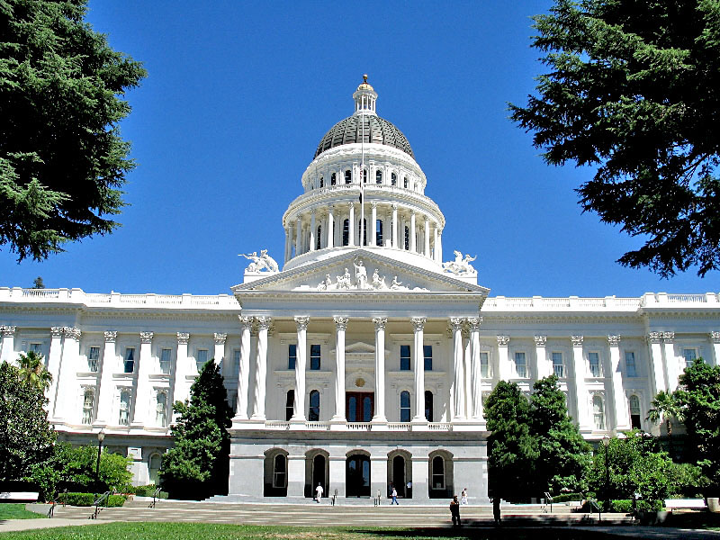
Concluding Thoughts
Contact Information:
Ashley Walker, Policy Advisor, Nossaman LLP
awalker@nossaman.com
916-930-7780
Valentina Purtell, Provost, North Orange Continuing Education
vpurtell@noce.edu
714-808-4670

